Slide 1
Face Mask Classification
Group 2
Morgan P. Suhas Y. Sheryl S. Bini B.

Slide 2
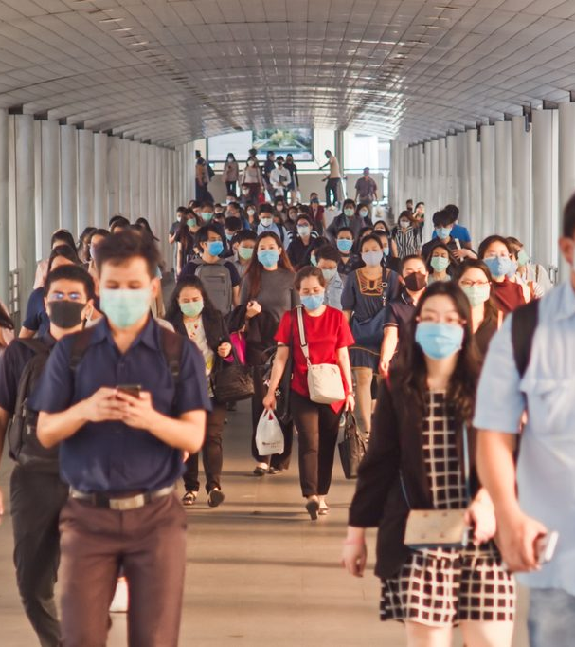
Face Mask Classification – Images Dataset
The Covid-19 virus has impacted our lives since 2019.
Since then, wearing a face mask has become essential to prevent wide-spread transmission of the virus.
This project is developed intended to help mitigate the current covid-19 situation
Using images, we intend to determine whether a mask is being worn or not.
With the use of Convolutional Neural Networks (CNNs) we intend to train an image classification model.

Slide 3
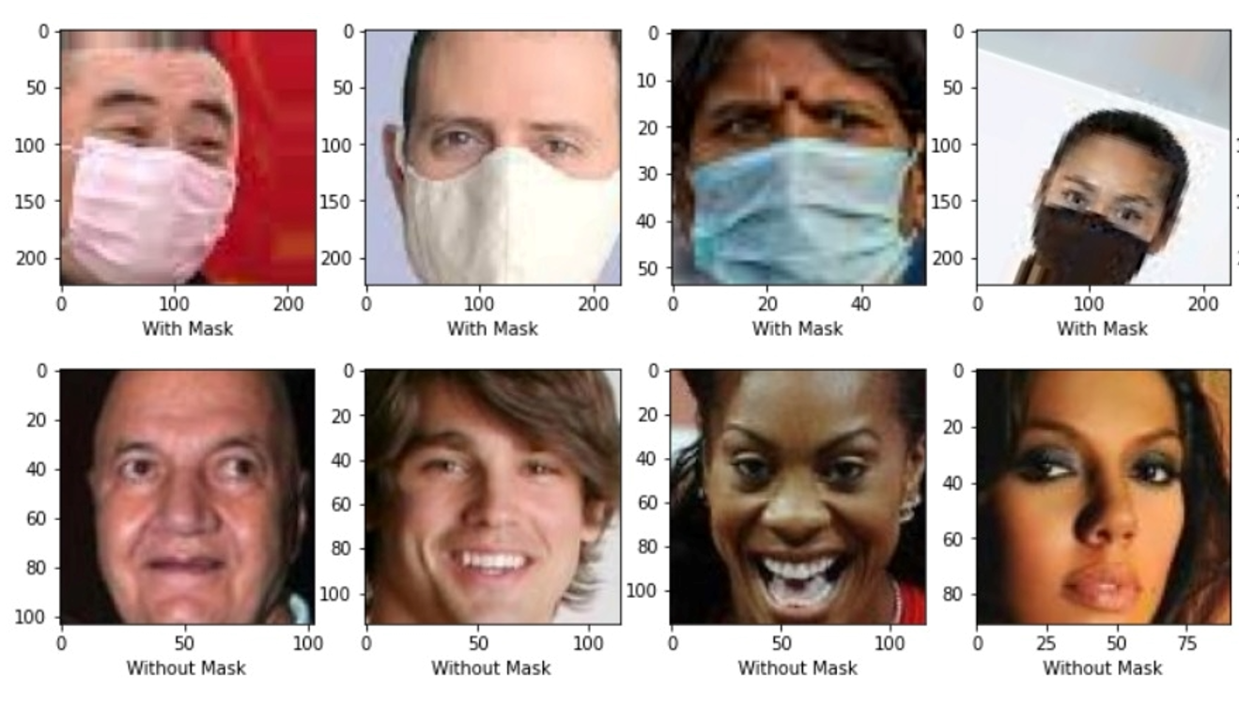
Face Mask- Classification
Dataset Details
The dataset consists of around 12,029 images
Train folder:- 10000 images
Test folder:- 1229 images
Validation folder :- 800 images
The images belongs to 2 classes -With mask & without mask
Sourced from a Kaggle

Slide 4
Demonstration of Steps
Data Processing & Augmentation :- Manual cleaning of irrelevant images obtained using Google API’s & combined these images with the Kaggle data
Data collection:- Collected data from Kaggle dataset as well as images obtained using Google API’s
Model Implementation :- CNN architecture was employed
Attempted Improved model :- Vgg19 is implemented
Predictions :- Evaluation of the model on unseen images
Classification :- Binary image classification (with & without masks) is performed

Slide 5
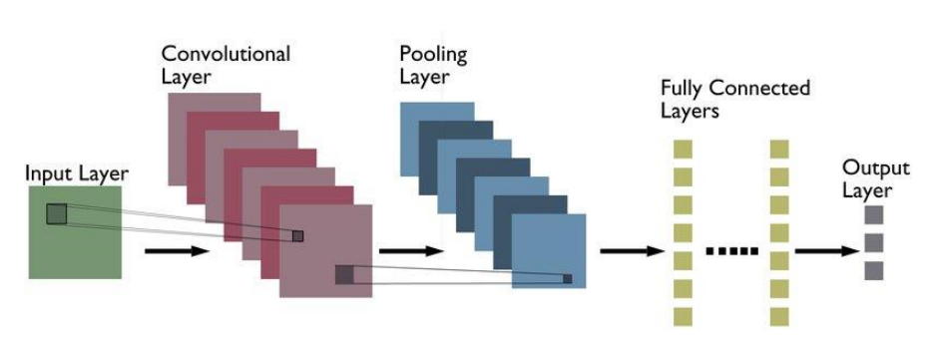
Model Implementation
Our CNN architecture consists of
An input layer, which takes into account the raw images
Convolution layer, which is responsible for majority of the computation
Pooling layer, used to perform dimensionality reduction (reducing the no: of parameters in the input)
Fully connected layers, which consist of neurons, weights and biases and helps in classification of the input data
Output layer, which uses softmax as the activation function and consists for two dense neurons denoting the two output classes.

Slide 6
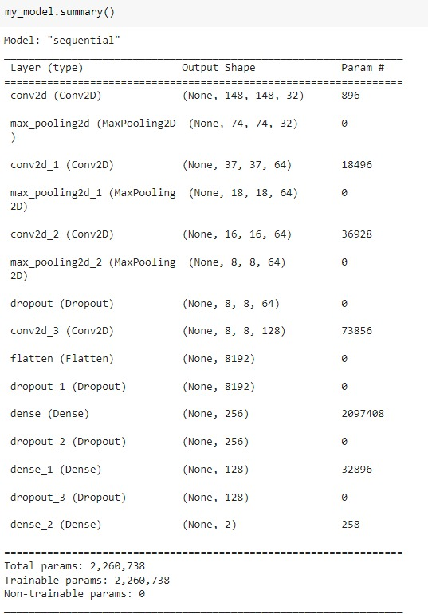
Model Implementation(contd..)
The model summary with output shape and number of parameters is as shown
The model consists of four Convolution layers, three max pooling layers, four dropout layers to minimize overfitting, two dense layers to perform classification and an output layer

Slide 7
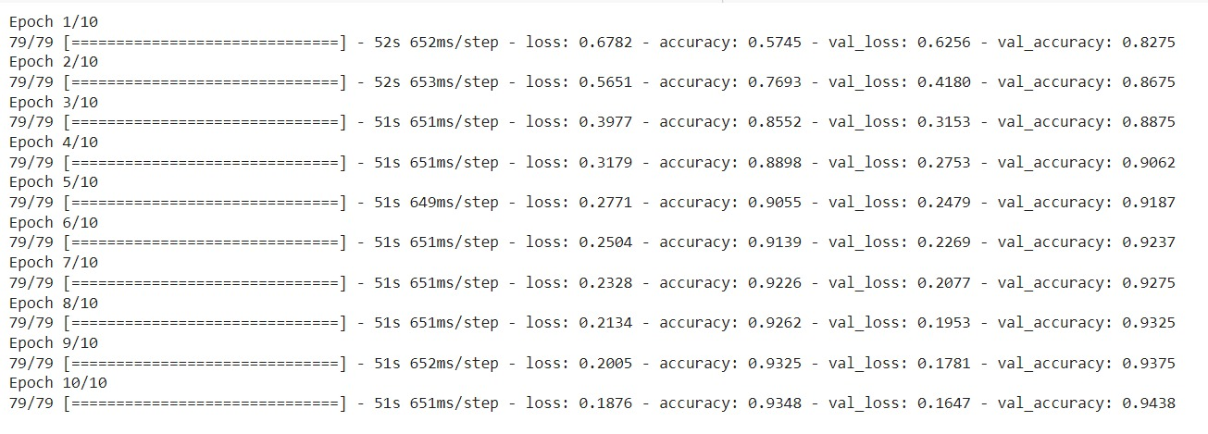
Classification
Compiling & training the model
After compiling the model with the optimizer as “adam”, the loss function as “categorical_crossentropy” and setting the metrics to “accuracy”, the model is trained for 10 epochs with a batch size of 128
Obtained validation accuracy = 94.38%

Slide 8
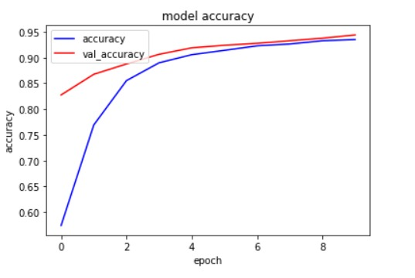
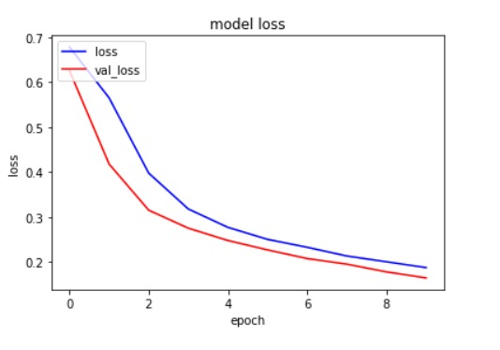
Performance Curves
The accuracy and loss curves for the implemented model for the given 10 epoch is shown below

Slide 9
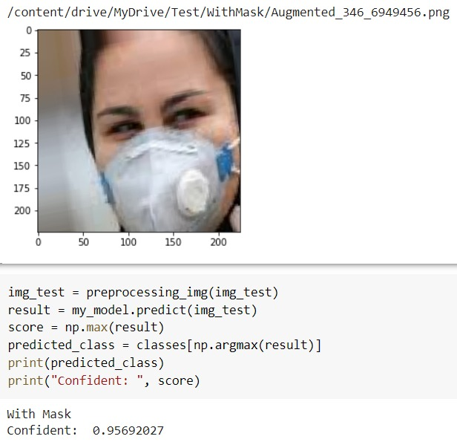
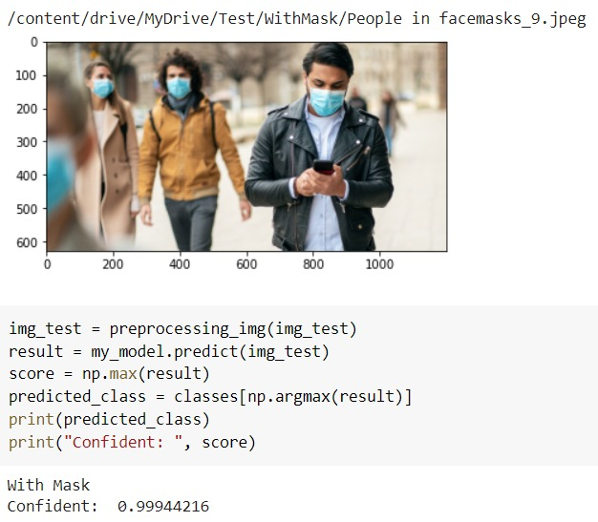
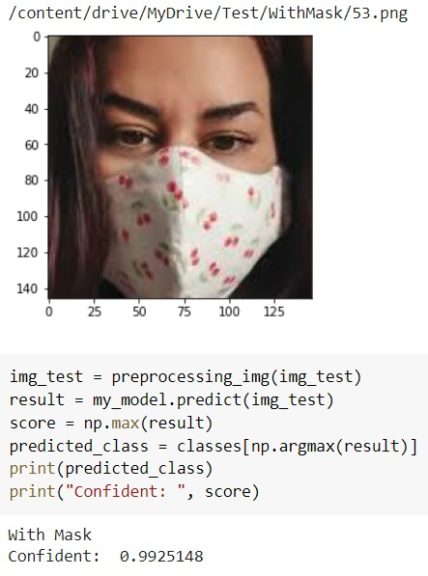
Detection on Test Images
The predictions made on the class- ‘with mask’ is shown

Slide 10
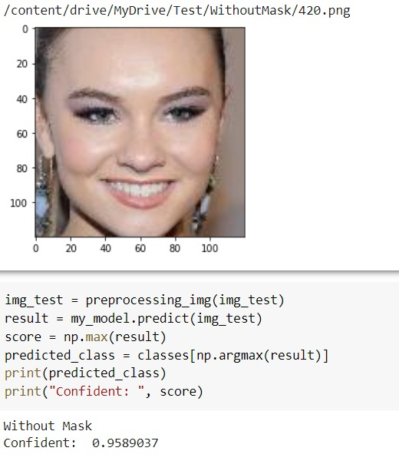
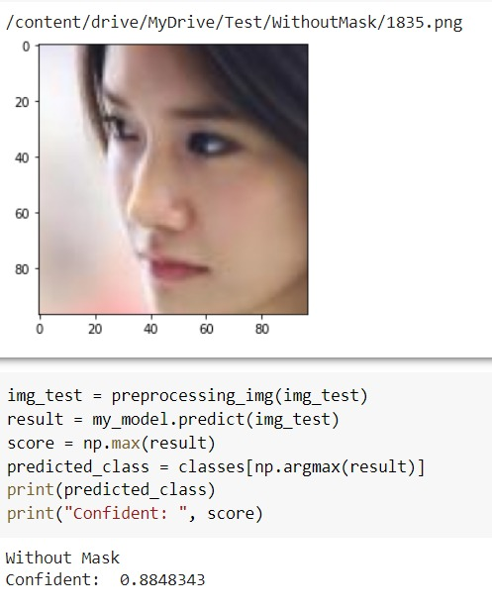
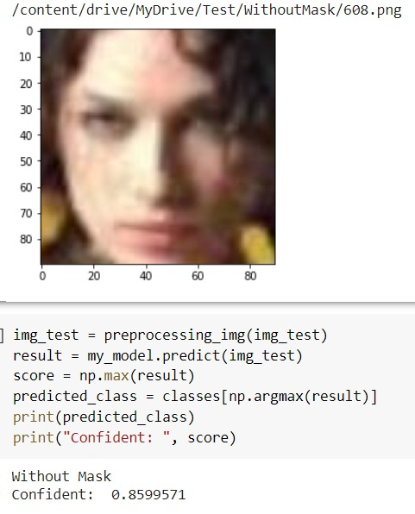
Detection on Test Images(contd..)
The predictions made on the class- ‘without mask’ is shown

Slide 11
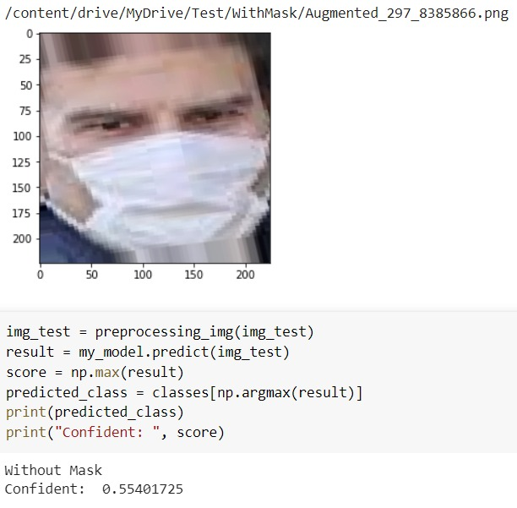
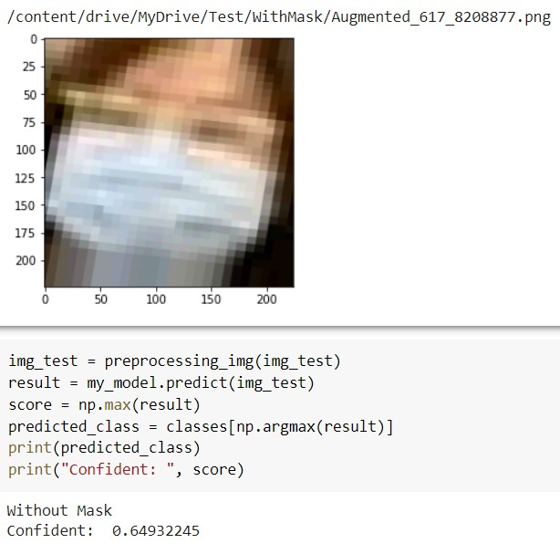
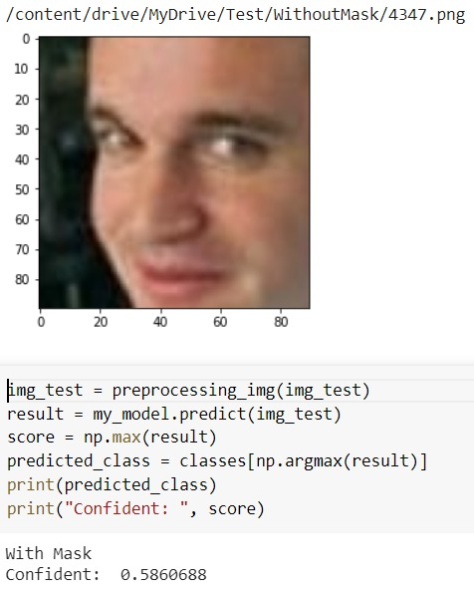
Detection on Test Images(contd..)
Some of the wrong predictions is as follows

Slide 12
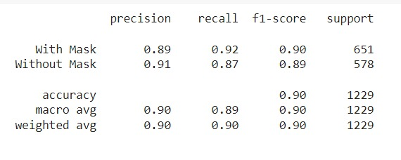
Classification Report
The classification report of the model is obtained which gives the details regarding the precision, recall and f1 score of the model
Precision shows the ability of the model in predicting the positives out of all the positive predictions that the model made
Model Recall/sensitivity is the ratio of true positive and the sum of true positive and false negative
F1 score of the classification report shows the accuracy performance of the model on each class

Slide 13
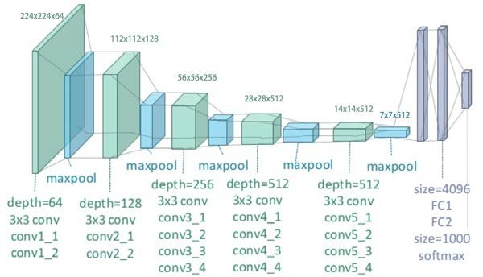
VGG19
Our CNN architecture consists of
Pre-procesing image layer that takes pixel values and subtracts the mean image values which is calculated over the entire ImageNet training set.
19 total layers
16 convolutional layers
3 fully connected layers
5 pooling layers

Slide 14
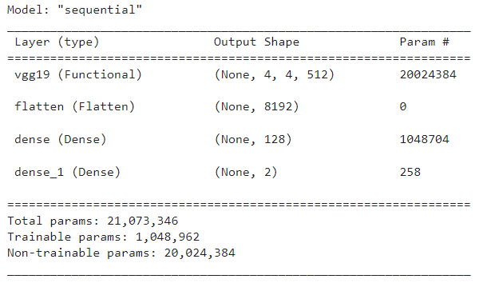
Model Summary
Our layers:
Vgg19 input layer
Dense Layers:
ReLU activation input layer
Sigmoid activation as an output layer
Flatten takes our data and converts it into a 1-dimensional array for inputting into the next layer

Slide 15
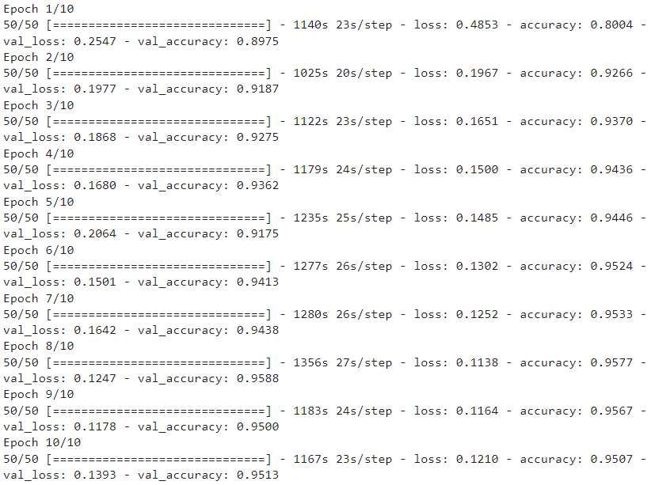
Classification
Compiling & training the model
After compiling the model with the Adam optimizer
the loss function: categorical_crossentropy
the model is trained for 10 epochs with a batch size of 200
Obtained validation accuracy = 95.13%

Slide 16
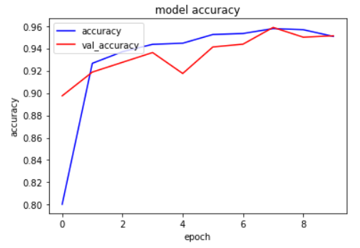
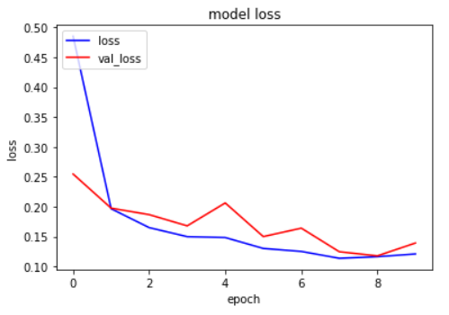
Performance Curves
The accuracy and loss curves for the implemented model for the given 10 epoch is shown below

Slide 17
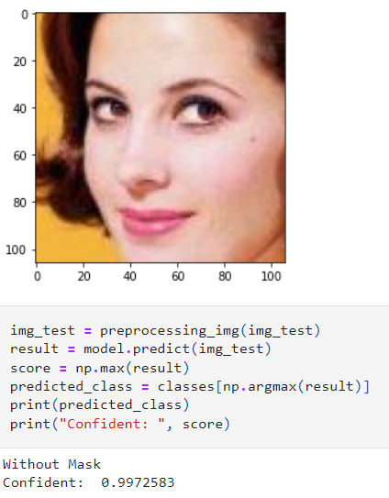
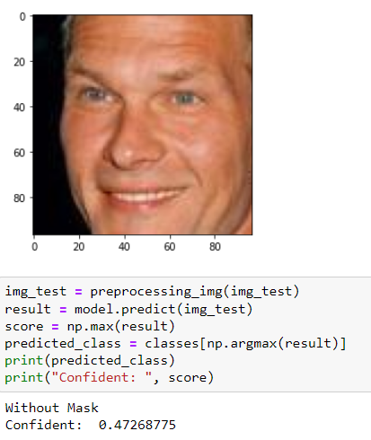
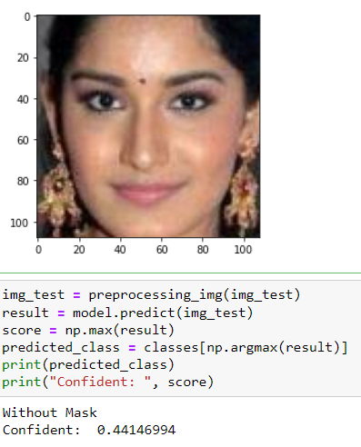
Detection on Test Images
The predictions made on the class- ‘without mask’ is shown

Slide 18
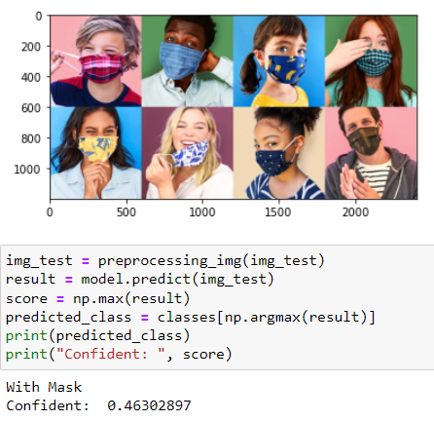
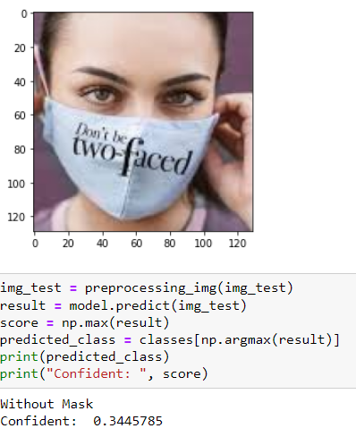
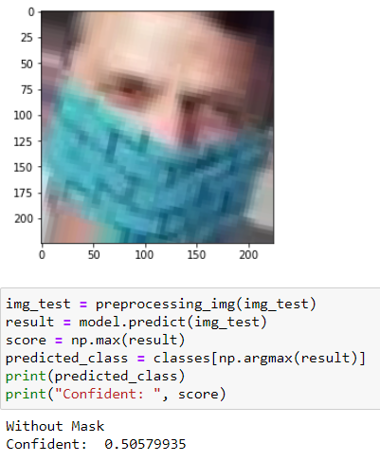
Detection on Test Images
The predictions made on the class- ‘with mask’ is shown

Slide 19
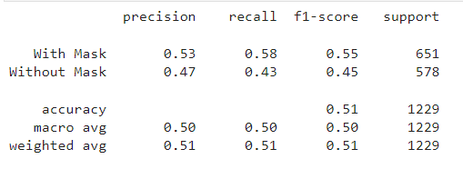
Classification Report
The classification report of the model is obtained which gives the details regarding the precision, recall and f1 score of the model
Precision shows the ability of the model in predicting the positives out of all the positive predictions that the model made
Model Recall/sensitivity is the ratio of true positive and the sum of true positive and false negative
F1 score of the classification report shows the accuracy performance of the model on each class

Slide 20
Conclusion: Accuracy of Models
A way of assessing the performance of our model.
Model accuracy is the number of classifications a model correctly predicts divided by the total number of predictions.
First Attempt
Second Attempt with VGG19
How to improve accuracy for future models
Tuning model parameters
Adding more data samples
Feature selection
Multiple Algorithms

Slide 21
Thank you
Any Questions?

